Slide 1


ParkEase: One App for Every Parking Spot in Kenya
Welcome to ParkEase, Kenya’s innovative solution to fragmented parking challenges. Our app offers seamless access to every parking spot across counties, private lots, and estates with a single, unified platform.
Designed for drivers and businesses alike, ParkEase simplifies parking by integrating payments, location-based services, and parking management into one smart app. Join us as we revolutionize parking in Kenya starting today.
by Joash

Slide 2

The Problem: Fragmented and Inefficient Parking Systems
Disjointed Parking Networks
No Unified Payment Method
Kenya’s towns and cities suffer from multiple disconnected parking systems, confusing drivers and complicating access.
Payment options vary by county, estate, or private lot, forcing drivers to carry multiple payment modes or cash.
Waste and Congestion
Drivers spend excessive time and fuel searching for parking, causing traffic snarls and environmental strain.

Slide 3
The Solution: One Digital Card and Mobile App
Universal Access
Smart Features
A digital card and app platform that works seamlessly across counties, private lots, estates, valet, and peer parking services.
Location-based parking suggestions
One-tap secure payments
Instant receipts and notifications

Slide 4
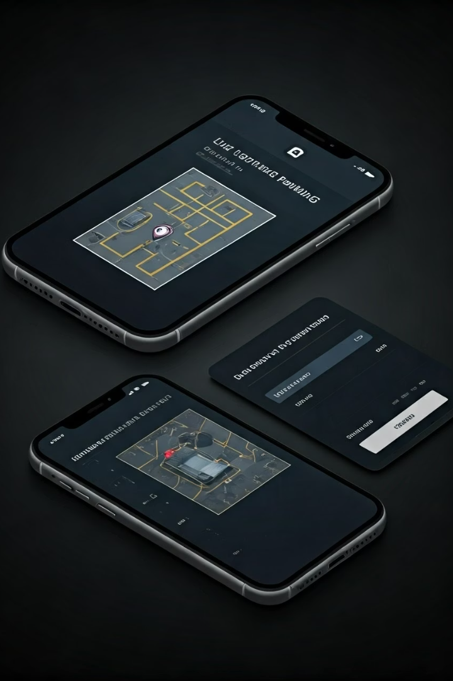




Product Demo: How ParkEase Works
Locate
Find available parking spots displayed live on the intuitive map.
Park
Reserve or access your chosen spot using the app or digital card.
Pay
Seamlessly pay with wallet, mobile money, or linked card options.
Receipt
Receive instant digital confirmation for your records.

Slide 5

Business Model: Multiple Revenue Streams
Subscription Revenue
B2B Partnerships
Targeted Local Ads
Users pay a monthly fee of Ksh 150, ensuring an ad-free, premium experience.
Counties, malls, and corporate parking providers use our white-label solution or API licenses.
Optional advertising from local Kenyan businesses enhances monetization with relevance.

Slide 6
Go-to-Market Strategy for Rapid Adoption
Pilot Launch
1
Focused in Nairobi, Mombasa, and Kisumu with collaborative county and private operators.
Referral Programs
2
Early adopter incentives encourage rapid user base growth among drivers.
Marketing Campaigns
3
Integrated digital, influencer, and on-ground brand ambassador efforts to boost visibility.
B2B Sales
4
Dedicated teams targeting enterprise and government partnerships to scale platform adoption.

Slide 7
Competitive Landscape: Why ParkEase Leads
Universal Coverage
Integrated Wallets
Peer-to-Peer Access
Custom APIs
Unlike MojaPay and Sunpay, ParkEase works across all counties and private lots seamlessly.
Supports M-Pesa and card wallets for effortless payments unavailable elsewhere.
Businesses and developers can build tailored solutions on top of ParkEase’s platform.
Allows estate and office parking sharing, a unique feature distinguishing ParkEase.

Slide 8

Traction & Roadmap: Poised for Growth
1
MVP Completion
Achieved by December 2025, validated with six operators expressing interest.
2
Beta Launch
Set for Q1 2026 with initial user onboarding and operational testing.
3
User Growth
Targeting 50,000 users by Q3 2026 through aggressive marketing and partnerships.
4
Expansion
Plan to extend service to 10 major Kenyan towns by the end of 2027, scaling impact.

